Slide 1
Thalassemia in the Future: A Changing Landscape
Thomas Coates, MD
Section Head of Hematology,
Children's Center for Cancer and Blood Diseases and Bone Marrow Transplantation
Children's Hospital Los Angeles
Professor of Pediatrics and Pathology
University of Southern California Keck School of Medicine, Los Angeles, California

Slide 2
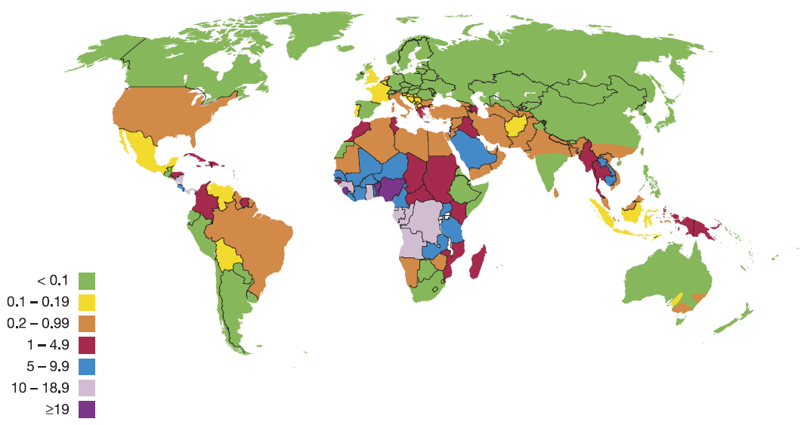
Hemoglobinopathy is a world wide health problem
Pathological Hb disorders per 1,000 live births
>350,000 children are born each year with a severe inherited Hb disorder
4% of deaths in children aged under 5 years
7% of the world population carries a significant variant
3 % of the world population is heterozygous for beta thalassemia.
75% of immigrants to the United States are from areas where thalassemias are prevalent
(WHO, June 2008 ; Weatherall DJ, Blood 2010,Piel FB Hematol Oncol Clin N Am2016 )
Notes:
2
2
No change

Slide 3
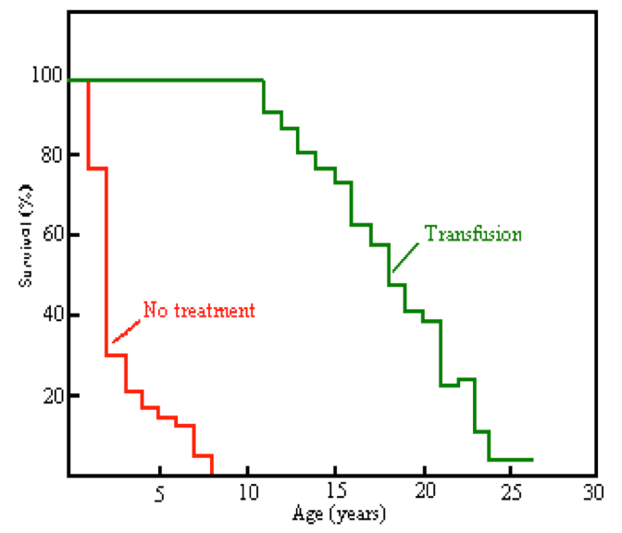
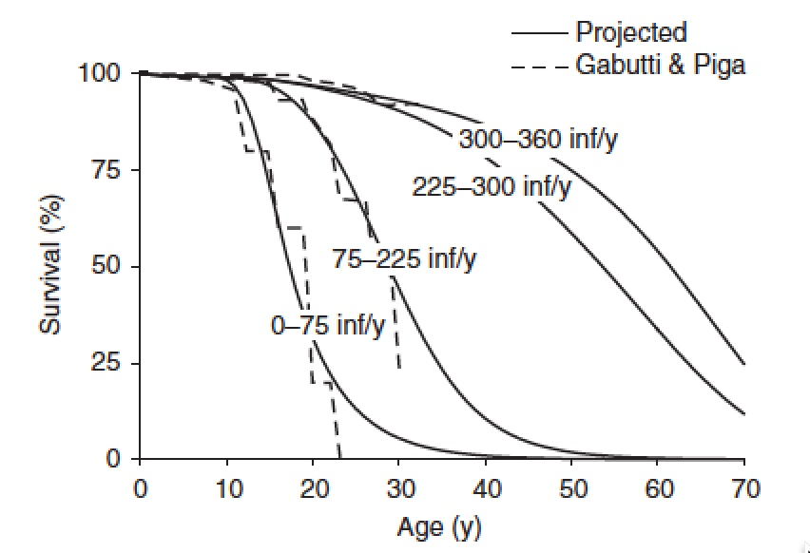
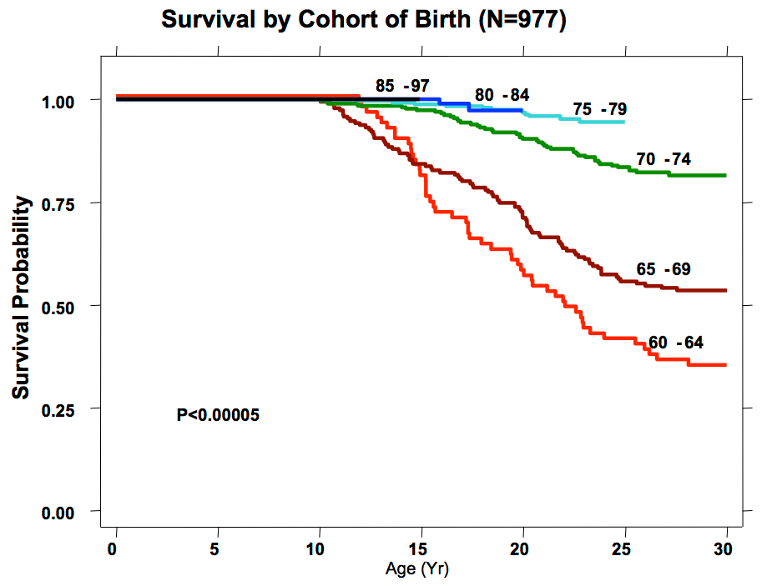
The survival in thalassemia has improved dramatically
1960’s
1970’s
Median 63 years
Berdoukas v, Modell B 1984
Delea T, et al, 2007 Pharacoecon. 25(4)
Gambutti V, Piga 1996, Acta Haem 95:26

Slide 4
Iron Induced Cardiac Disease in Patients with Thalassemia Major - Main Cause of Death in Patients in the UK up to 1999
71% reduction
Marked improvement in understanding of iron physiology, ability to monitor organ iron by MRI, and availability of three good chelators are responsible for the improved survival in decreased disease burden.
Iron cardiomyopathy is now preventable and treatable
Endocrine failure is preventable and somewhat reversible.
The issues causing morbidity and mortality can be overcome if patients have access to medical care and can collaborate with providers with special expertise in thalassemia and treatment of iron overload.
Knowledge is power.
Modell. J Cardiovasc MR 2008: 42
Notes:
Can wIn 1999, T2* CMR was introduced in the UK, and doctors caring for thalassemia patients were informed of the high cardiac death rate and new options for iron chelation therapy. There has been a 71% reduction in the annualized death-rate from iron overload since 2000.
Canadian physicians are well-aware of data from around the world showing increased survival of patients treated with deferiprone, and all of the major U.S. centers have sought deferiprone access through compassionate use for patients who have failed other strategies.

Slide 5
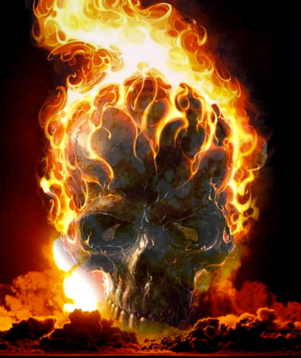
The non-transferrin bound iron you cannot see by MRI is the cause of toxicity
Iron Toxicity ≈ Tissue labile iron X Environmental factors X Genetics X
TIME
(decades of exposure to low levels of iron is dangerous)
Inflammation
Fe⁺² acts as a powerful amplifier of oxidant damage through formation of singlet oxygen and hydroxyl radicals
LPI / LCI
Heme
We do not know the long term effects in adolescents and adults of previous transient exposure to reactive labile iron .

Slide 6
Good news: Survival is much better
The bad news: Survival is much better
Thalassemia patients now have the opportunity to develop all of the medical problems associated with old age that have been denied to them in the past!
60+ years of exposure to low levels of iron
Malignancy
Non transfused thalassemia (NTDT) patients have a 5 times higher risk of leukemia and 2 times risk of abdominal cancer
Transfused thalassemia patients (TDT) have a 9 times higher risk of abdominal cancer and leukemia than NTDT patients
Cardiac and endocrine disease
60+ years of exposure to anemia
Silent strokes / low brain oxygen delivery reserve
Cardiac disease / pulmonary hypertension
Extramedullary hematopoiesis, bone disease
The thalassemia community needs to seriously reconsider the treatment recommendations in light of improved survival.
Normalize iron levels
Maintain hemoglobin in a more normal range.
Chung et al, Apr 2015 J Epidemiol Community Health 0:1-5
Coates T, et al 2016 NYAS 1356(1):95
Taher A, et al 2018 Blood 132(17):1781

Slide 7
There is more good news:
The issues with iron exposure may be reversible
Cardiac iron overload can be reversed and direct effects of iron on the ability of the hear to contract can be reversed. There may be long term effects on stiffness of the heart and rhythm disturbances, so follow-up with a heart specialist is important
There is a very good chance the malignancy risk can be reduced by lower iron
Some endocrine dysfunction can be reversed with tight control of iron.
Probably most of the complications of thalassemia due to chronic anemia and iron overload can be prevented by maintaining adequate hemoglobin levels and tight iron control.
Carnac Coates predicts the possibility of a bright and healthy future for thalassemia patients born in the last few decades even without fancy new treatments

Slide 8
There are new treatments and the possibility of cure
Bone Marrow Transplantation
Matched sibling transplantation recommended for thal major
Unrelated donor transplant outcomes much better in past 10 years and should be considered.
The risk stratification for BMT is outdated and we really do not know the outcomes if iron burden is truly normalized prior to BMT.
Luspatercept
Reduces the component of anemia due to ineffective erythropoiesis.
Reduces transfusion burden and can increase hemoglobin level in thalassemia intermedia (non transfusion dependent thalassemia)
Injection every three weeks.
Gene Therapy
Offers chance for transplant to those who cannot find an adequate donor.
Has all the risks of BMT with likely reduced GVHD

Slide 9
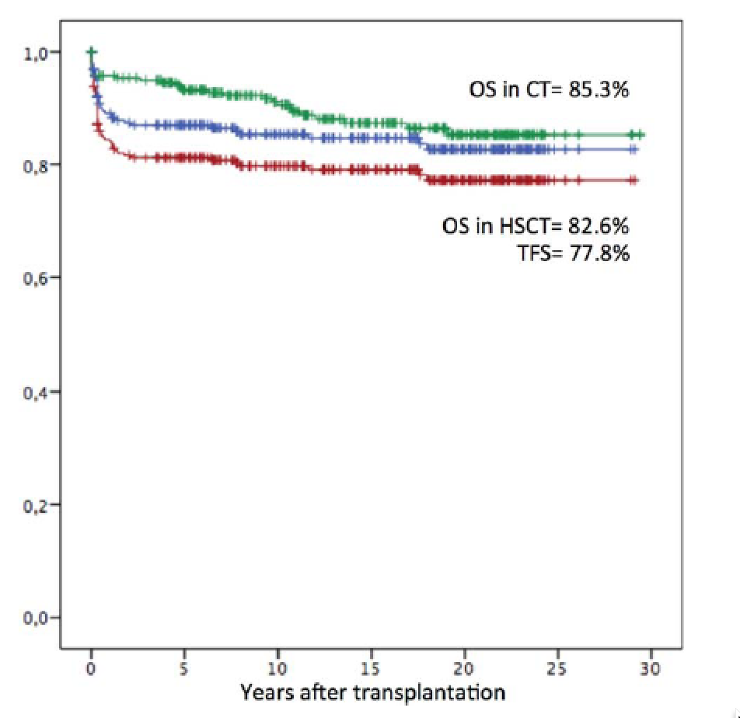
To transplant or not to transplant: A difficult decision
< 16 yo
> 16 yo
At least 71% alive at age 46
258 thalassemia med age 12 (1-45) 67% sibling (HSCT) blue
258 thalassemia matched on conventional therapy (CT) green
Note that all of these curves will be adversely affected by poor iron chelation
Caocci et al, 2017 AJH, 92:1303
Notes:
nFIGURE 1 30-year Kaplan–Meier probabilities of overall survival (OS) after hematopoietic stem cell transplantation (OS after HSCT, blue curve) and thalassemia-free survival (TFS, red curve) in 258 transplanted patients and OS landmark analysis in 258 age-sex matched patients conventionally treated (CT, green curve). OS was 85.362.7% and 82.662.7% in thalassemia control and transplanted
patients respectively (P5NS); TFS was 77.862.9% [Color figure can be viewed at wileyonlinelibrary.com]
FIGURE 2 23-year Kaplan–Meier probabilities of overall survival after hematopoietic stem cell transplantation (OS after HSCT, blue curve) and thalassemia-free survival (TFS, red curve) in 97 adult (age16 years) transplanted patients and OS landmark analysis in 97 age-sex matched patients conventionally treated (CT, green curve). OS was 7065% and 71.265% in thalassemia and transplanted patients respectively (P5NS); TFS was 67.365% [Colorfigure can be viewed at wileyonlinelibrary.com]

Slide 10
Thalassemia patients now, more than every need comprehensive care
The decisions regarding overall therapy, especially transplant approaches require collaboration between patients and providers with broad understanding of all aspects of thalassemia
Taher, A 2018, Blood 132(17) 1781

Slide 11
The future is bright
Maintain hemoglobin levels as high as possible
Maintain iron levels consistently as near normal as possible and safe (no cardiac iron, no pancreatic iron, no pituitary iron, Labile plasma iron near zero, liver iron near normal)
Follow all recommendations for a healthy life style and continue comprehensive care to additionally focus on thalassemia related issues.
Curative treatments are already possible and the approaches and availability will improve in the next decade

Slide 12
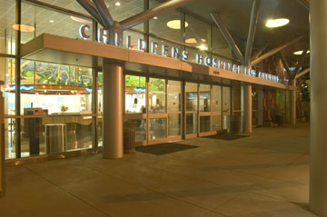
Thank you for your attention

