Slide 1

Thalassemia:
Therapies in Development
Ashutosh Lal, MD
Comprehensive Thalassemia Center & The Iron Disorders Program
Professor of Clinical Pediatrics
UCSF School of Medicine
UCSF Benioff Children’s Hospital Oakland

Slide 2
Disclosures
Site Principal Investigator on Research Studies
  Bluebird Bio
  Celgene (plus consultancy and advisory board)
  La Jolla Pharmaceuticals
  Protagonist (plus steering committee membership)
  Terumo
Co-Investigator
  Agios
  Sangamo

Slide 3
Thalassemia: Many Diagnoses
Beta | Alpha
β Thal Trait MILD ANEMIA | α Thal Trait MILD ANEMIA
β Thal Intermedia MOD ANEMIA | Hb H Disease MOD ANEMIA
E β Thal MOD-SEVERE ANEMIA | HbH Constant Spring MOD-SEVERE ANEMIA
β Thal Major SEVERE ANEMIA | α Thal Major SEVERE FETAL ANEMIA

Slide 4
Conventional Treatment of Thal Major
The overall goal is effective transfusion therapy
Prevent symptoms from anemia
Prevent bone marrow expansion
For transfusion therapy to be successful -
Prevent the complications of transfusions
Control the iron overload that results from blood transfusions
Develop support mechanisms to allow uninterrupted delivery of therapy

Slide 5
Disease Modifying Therapies
Increase beta globin synthesis
  Stem cell transplant*
  Beta globin gene therapy*
  Repair mutation with gene editing
Reduced beta globin synthesis
Increase gamma chain synthesis
  BCL11A disruption*, strategic mutations in beta gene cluster
  HU*, butyrate*, decitabine*, metformin, thalidomide, benserazide
Reduce alpha globin synthesis
  siRNA
Reduce relative alpha globin excess
  Hepcidin*, Erythroferrone, apoTRF
  HRI/salubrinal
Excess alpha globin chains
Reactive Oxygen Species
Antioxidants
  Rapamycin, resveratrol
Reduce Jak2 signaling
  Ruxolitinib*
Preserve GATA-1
  HSP70/leptomycin
Improve ATP levels
  Pyruvate Kinase R activator*
Reduce GDF11 signaling
  Luspatercept*
Ineffective Erythropoiesis
Maturation arrest
Apoptosis
* In clinical trials
Notes:
ASH2016 presentations: 852 Ruxolitinib
1013: TMPRSS6
1012: Jak2 and HIF2a
1284: GLYT1 inhibitor
Cold Spring harbor Collections on Hemoglobin

Slide 6
Bone Marrow Transplantation
Replace ineffective hemoglobin producing cells with effective stem cells from donor that can make normal hemoglobin
Benefits
Transfusions no longer needed
Body iron level can return to normal
Risk of liver damage is reduced
Risk of cardiac damage from iron is eliminated
Health-related quality of life is improved
Risks
Graft-failure, graft-vs-host disease, infections, and risk of death during or after the procedure
Most patients will be infertile, though cases of successful pregnancies are reported
Chemotherapy used for BMT can also damage the endocrine glands

Slide 7
Bone Marrow Transplantation - Results
European BMT Results 2000-2010, 1500 patients, Baronciani, BMT 2016

Slide 8
Outlook for alternative donors
Problems: graft-versus-host disease, graft failure, infections, death
Pre-implantation genetic diagnosis
  Test embryo for thalassemia and HLA-match
Expanded umbilical cord blood stem cells
  To allow use of unrelated cord blood
Unrelated donor protocols
  Extended HLA matching and immunosuppression
Haplo-identical family donors
  Parents or siblings are donors
  In last 3 years, 2 groups (Thailand and China) have reported cure >90%
Intra-uterine haplo-identical BMT
  Current Alpha Thalassemia Major trial
  Future Beta Thalassemia Major trial
Acceptable probability of
mortality <5%
graft failure <10%

Slide 9
New Therapies Under Development
Curative - Gene Therapy
Gene addition
Gene correction
Restore fetal hemoglobin production
Reduce transfusions
Increase survival of developing red cells in bone marrow
Reduce iron burden
Prevent iron from entering the heart and other tissues

Slide 10
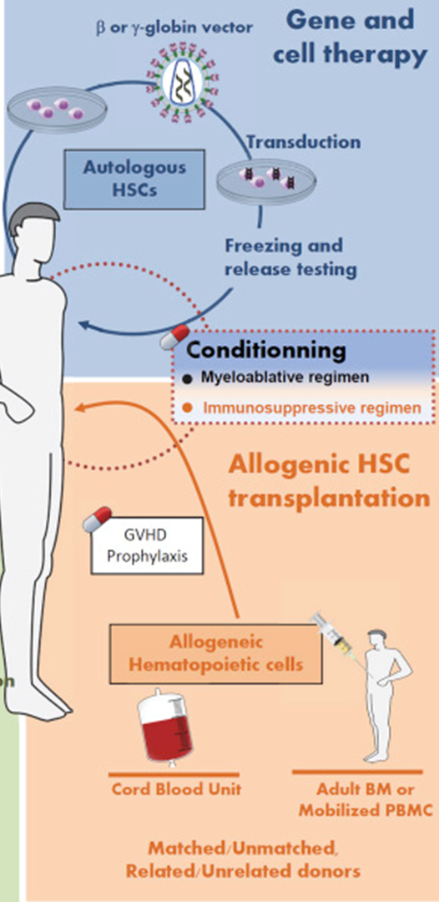
Gene Therapy | BMT
Autologous Stem Cells (Own Cells) are removed from the patient’s body | Allogeneic Stem Cells (Other Cells) are removed from the donor’s body
Stem cells are modified with a virus or non-virus method | --
Thalassemia marrow is eliminated by chemotherapy | Thalassemia marrow is eliminated by chemotherapy
-- | Patient’s immune system is suppressed with medicines
Modified cells are returned to the patient by infusion | Donor cells infused into the patient
Source: Bluebird bio

Slide 11
LentiGlobin Gene Therapy
Beta0 mutation: No normal hemoglobin produced
Beta+ mutation: Some normal hemoglobin produced
          includes E mutation
Genotype – Describes the type of mutations in a person
  Beta0/Beta0
    Indicates low capacity for endogenous hemoglobin
  Non-Beta0/Beta0: (Beta+/Beta+; Beta0/Beta+, E/Beta0)
    Indicates more capacity for endogenous hemoglobin
Northstar Clinical Trials
Sponsor: Bluebird Bio
Multicenter, international
In United States: Oakland, Chicago and Philadelphia
HGB 204 Original manufacturing process
          All Genotypes (n=18)
HGB 207 Refined manufacturing process
          Non-beta0/beta0 (n=23)
HGB 212 Refined manufacturing process
          beta0/beta0 (n=15)

Slide 12
HGB-204
Non-β0/ β0: 8/10 subjects stopped transfusions
β0/ β0:
4/8 subjects stopped transfusions
Source: Bluebird bio, New England Journal Medicine; and Thompson et al New England Journal of Medicine. 2018

Slide 13
HGB-207: Non-Beta0/Beta0
Last Hemoglobin
13.3
--
11.3
12.1
12.3
12.5
12.4
12.4
11.5
11.0
12.6
11.3
8.8
13.3
Total hemoglobin = Endogenous hemoglobin: F, E, A
+
Hemoglobin from new gene: T87Q

Slide 14
HGB-212: Beta0/Beta0
4 subjects evaluated at 6 months
Total hemoglobin 10.7-13.8
T87Q >80%

Slide 15
Gene Therapy: Availability
Brand name: ZYNTEGLO
European Union Approval: June 2019
  Transfusion-dependent thalassemia
  Non-Beta0/Beta0 genotype only
  12 years and older
  No HLA-matched related stem cell donor available
Undergoing approval process with FDA
  Expected approval 2020
  Availability in select centers

Slide 16
Gene Therapy:
Increase Fetal Hemoglobin
BCL11A
+
−
Hemoglobin Genes
BETA
GAMMA
Fetal Period
HbA
HbF
After Birth
HbA
HbF
Beta Thal
HbA
HbF
BCL11A inactivation
Beta-thalassemia: adult hemoglobin is not made, but can be replaced by fetal hemoglobin
ST-400: Stem Cells modified with Zinc-Finger Nuclease to inactivate BCL11A (Sangamo)
CTX001: CRISPR/Cas9 is used to modify stem cells to inactivate the BCL11A gene

Slide 17
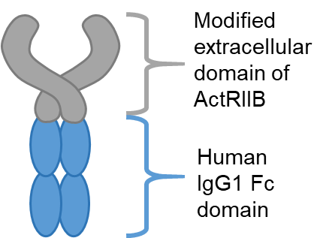
Luspatercept: BELIEVE Clinical Trial
Improves maturation of developing red blood cells
Subcutaneous inj every 3 weeks
Binds to TGF-β superfamily activators (GDF11), reduces signals that destroy immature red cells
More red cells mature, so body can make more hemoglobin
This reduces the need for blood transfusions
Multicenter, international, randomized
  65 sites, 15 countries
Inclusion criteria:
  Aged ≥ 18 years
  β-thalassemia or hemoglobin (Hb) E/β-thal
  Regular transfusions 6–20 units over 24 weeks
336 subjects:
  224 received luspatercept
  112 received placebo
Duration of treatment 48 weeks
Open label extension up to 5 years

Slide 18
Phase 3 trial of Luspatercept versus placebo
Primary Endpoint
  >33% reduction in transfusion volume over 3-month period (week 13-24)
  21% in Luspatercept arm, 5% in Control arm achieved this endpoint
Secondary Endpoint:
  reduction in transfusion volume over any 6-month period
  >33% decrease: 41% LUSP vs 2.7% CTRL
  >50% decrease: 17% in LUSP and 1% CTRL

Slide 19
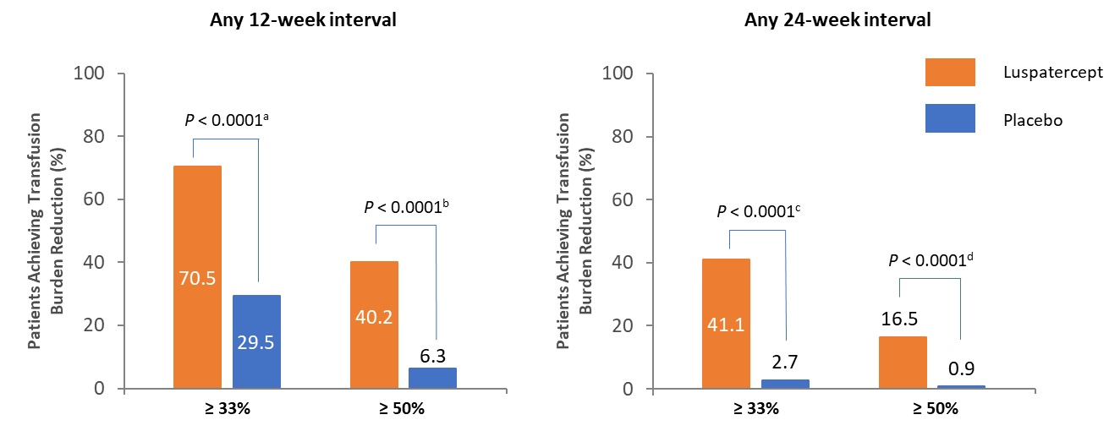
BELIEVE Trial:
Reduction in transfusion burden during 12- and 24-week interval
During any 12- or 24-week interval, a significantly greater proportion of luspatercept-treated patients achieved clinically meaningful reductions in transfusion burden of ≥ 33% and ≥ 50%
Source: Celgene website

Slide 20
Luspatercept
Side Effects
Generally well tolerated
Common side effects: Increase in bone and joint pain, dizziness: decrease over time
Uncommon side effects <3%: Increase liver iron, uric acid, hypertension, syncope, ALT, thrombosis
Availability
When: FDA approval possible by December 2019
Who: Age >18 years, transfusion-dependent

Slide 21
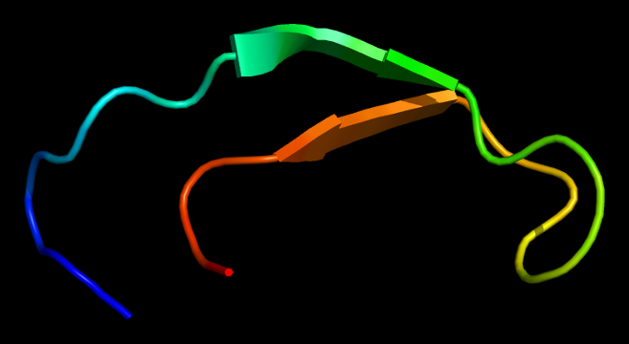
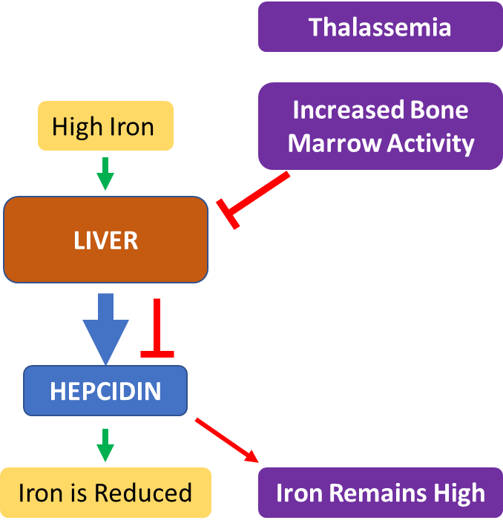
Hepcidin
Hepcidin is a hormone produced by liver to control the level of iron in the body
Hepcidin levels are reduced in thalassemia
Hepcidin given as injection lowers iron in blood

Slide 22

Hepcidin Clinical Trials
LJPC-001
  Full length hepcidin given subcutaneous injection once weekly to patients who have iron overload in the heart
  Question: Can hepcidin supplementation lead to quicker removal of iron from the heart when used with chelation?
PTG-300
  Modified hepcidin given subcutaneous injection once weekly
    Transfusion-dependent
    Non-Transfusion-dependent
  Question: Can hepcidin reduce the need for blood transfusions or raise hemoglobin by allowing body to make more blood on its own?

Slide 23

AG-348 in Non-Transfusion-Dependent Thalassemia
AG-348 is an activator of Pyruvate Kinase Enzyme in red cells (PKR)
  PKR increase the amount of energy available to the red cell
  Improved energy could make the cell likely to survive longer
  This may have an effect on hemoglobin
Orally active compound
Beta thalassemia intermedia
Hemoglobin H Constant Spring (first clinical trial for HCS)

Slide 24

What the future holds
Pace of discovery and clinical trials in thalassemia has accelerated
2 new therapies submitted for FDA approval
  LentiGlobin Gene Therapy
  Luspatercept
Multiple other approaches based upon understanding of how blood is made in bone marrow are being investigated
  Several alternative gene therapy approaches
  Several interventions to increase hepcidin levels
  Other targets to boost endogenous red cell production

Slide 25
Therapeutic decisions will become more increasingly complex...
Justified optimism for curative therapies/reducing transfusions
Conventional treatment has improved concurrently
  Patients expected to have normal longevity and good quality of life
  New treatment advances have to be measured against this success
  Very high-risk treatments or severe side effects will be difficult to promote
Choices will be complex for patients and families
  Decisions should be made in discussion with the team with whom they share a trusting relationship
  Patients who are well managed and have good control of iron will be the best candidates for curative options

Slide 26
Thank you to all our patients and families
For volunteering to participate in research
For keeping us on our toes

