Slide 1
Issues in health insurance: Engagement & Advocacy
Wendy Murphy, LCSW,
UCSF Benioff Children’s Hospital Oakland
Nimit Ruparel, MPP
Patient Advocate

Slide 2
Goals of Presentation
Provide a brief overview of what is important in choosing a health plan for someone with Thalassemia.
Highlight what to be aware of in advocating for health care now and in the future.
Demonstrate the “pitfalls” of choosing plans.

Slide 3
“While trying to figure out which medical plan to choose, Mark’s mind drifted to simpler topics,
like quantum physics”

Slide 4
Percentage by type of health insurance in the united states (2017)
Source: US Census Bureau, Current Population Survey 2018

Slide 6
Types of health insurance
PPO – Preferred Provider Organization
HMO – Health Maintanance Organization
EPO – Exclusive Provider Organization
POS – Point of Service

Slide 7
 | Pros | Cons
PPO | More provider options Out-of-network services available (Ex: Out-of-state for comprehensive care) | Higher monthly premiums Greater cost sharing expenses
HMO | Lower monthly premiums Reduced cost sharing | Requires doctor in-network & no out-of-network care Primary care provider (PCP) makes all the referrals
EPO | Can self-refer to specialists Reduced cost sharing expenses | Restrictive network of providers No out-of-network care
POS | Option for out-of-network care Lower monthly premiums | Primary care provider (PCP) makes all the referrals

Slide 8
Important factors
Annual Deductible – Cost before insurance pays
Annual Medical Out-of-Pocket – Maximum yearly amount
Annual Pharmacy Out-of-Pocket – Does it cover your Chelation medication?
Co-Pays – A fixed amount you pay (e.g. $10- $250)
Co-Insurance - What your health plan pays after deductible (Common PPO types are 80/20 or 90/10)
Network –
Is your Hematologist and hospital in the network?
Can you go “out of network” for comprehensive care?

Slide 9
Cost
Out-of-Pocket Maximum
Coverage
Annual Tests:
T2*, Liver MRI
Chelation Medication
Blood Transfusions
Deductible
Premiums
Co-pays/Co-Insurance
Hematologist/ Hospital In-Network

Slide 10
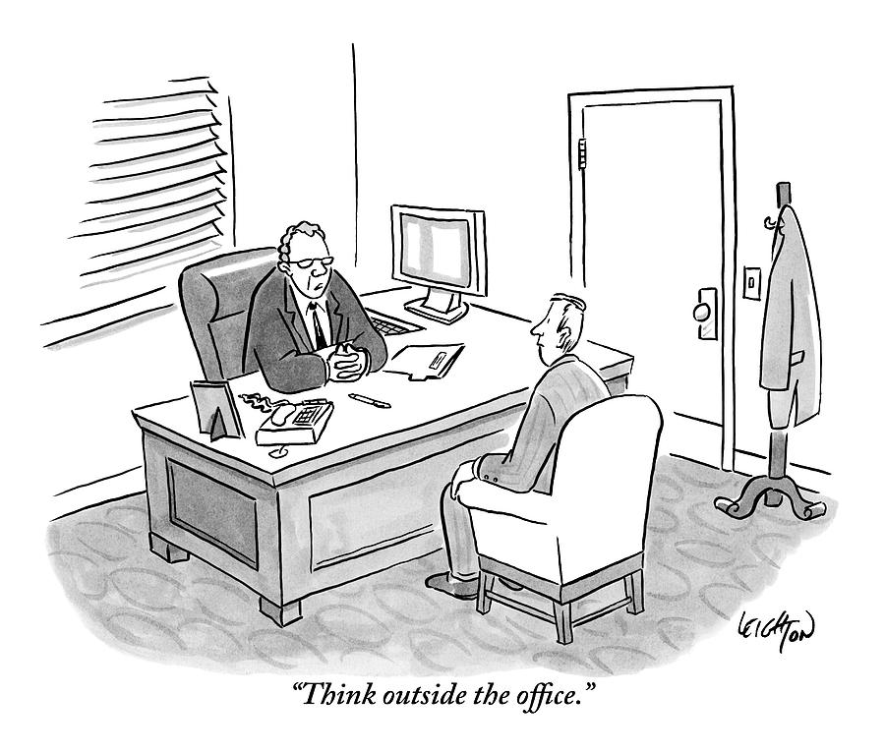
“We advise new employees to try not to get sick.
Our medical plan doesn’t cover illness”

Slide 11
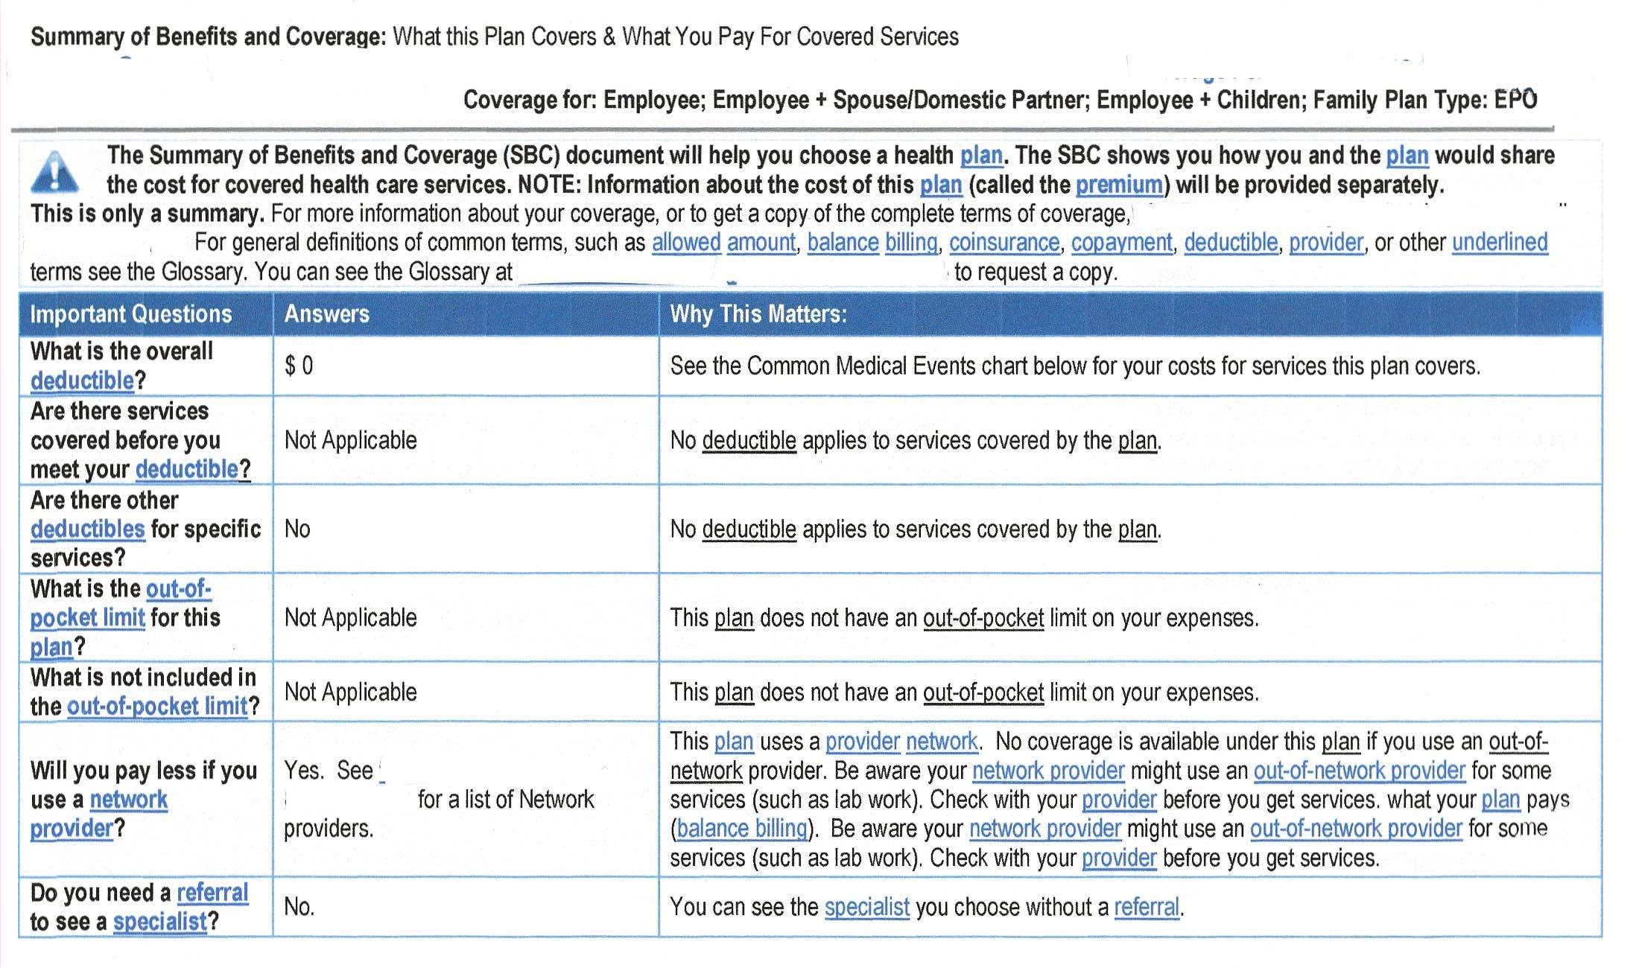

Slide 12
Looking closer…
Important Questions | Answers | Why This Matters
What is the overall deductible? | $0 | This plan begins paying immediately for covered services.
What is the out of pocket limit for this plan? | Not Applicable | This plan does not have an out-of-pocket limit on your expenses.
Do you need a referral to see a specialist? | No | You can see the specialist you choose without a referral

Slide 14
The Bad news…
Common Medical Event | Services You May Need | Network Provider | Out of Network Provider | Limitations & Exceptions
If you visit a health care provider’s office or clinic | Specialist Visit | Provider: No Charge Hospital Facility: Not Covered | Not Covered | If services rendered at a hospital facility services fees will apply
If you have a test | Imaging (CT scans, MRIs) | Not Covered | Not Covered | None
If you need drugs to treat your illness or condition | Preferred Specialty drugs Non-preferred Specialty drugs | Not Covered Not Covered | Not Covered Not Covered | Specialty drugs not covered

Slide 15
How does the aca protect you?
Requires plans to have ten essential health benefits
Protects against sub-par plans (non-comprehensive)
Protecting people with pre-existing conditions
Covers you and limits amount you can be charged
No life-time maximums
Does not limit coverage which could lead to bankruptcy
Keeps children on parent’s insurance until 26 years old
Access to full coverage until able to get a job with benefits

Slide 16
Challenges & loss of protections
Legal Challenges to ACA could result in loss of current protections (comprehensive plans, excluding pre-existing conditions & maximums)
States eroding protections through waivers by offering less comprehensive, sub-par plans and weakening protections
State laws guarding against federal repeals
Public option – Washington state

Slide 17
What can you do?
Keep informed about changes to health insurance policies & laws locally and nationally, subscribe to:
Kaiser Family Foundation
Robert Wood Johnson Foundation
Contact your State Representatives & Senators to express concern regarding any legislation that could take away protections.
Closely follow discussions on health care and proposed policies in the upcoming 2020 elections.

Slide 18
Issues in health insurance: Engagement & Advocacy
Wendy Murphy, LCSW,
UCSF Benioff Children’s Hospital Oakland
Nimit Ruparel, MPP
Patient Advocate

Slide 19
My Story
33 year-old patient with Beta Thalassemia Major
Receives care at Children’s Hospital Oakland (for 15+ years)
Studied health policy at UC Berkeley
Professional health care policy, strategy, & operations experience:
University of California (UC Health)
Manatt Health Solutions (healthcare consulting)
San Francisco Health Plan (county Medicaid plan)
UCSF

Slide 20
Doctor in-network?
Hospital in network?
Chelation covered?

Slide 21
“Your plan covers the administration of blood and blood products, but
not the cost of the blood or blood products.”

Slide 23
$2,000 per transfusion
X 27 transfusions
$54,000 total costs

Slide 24
Timeline
11 month gap in coverage
Genetically Handicapped Persons Program Coverage, Retroactive to May 2017
June
2016:
Started
New Job
October
2017:
First Bills
Begin Arriving
November
2017:
GHPP and
Community Care
Applications
Completed
December
2017:
Insurance
Company
Refuses
Payment for
Services

Slide 25
Key takeaways
Engage with health insurance at every life transition point
Review the benefits booklet, talk to your HR rep, and utilize the resources around you to minimize the types of issues I described in my case.
Ask for help
Health insurance is complicated and filled with jargon. Don’t let this intimidate you. Be proactive and ask for help with navigating it.

Slide 26
Key takeaways (Continued)
Get written documentation
Seek out written documentation to ensure that your coverage needs are being met.
Whether this means saving emails, letters, or documenting your phone calls, do whatever it takes to prove that your insurance is covering the services you need.
Prepare your children for this
Many parents think that they are doing their kid a service by handling all of these issues for them longer than they should.
In the short run you’re protecting them from additional stress, but sooner or later they will have to deal with these issues.

Slide 27
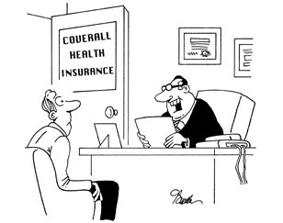
Key takeaways (Continued)
This stuff is challenging!
“I’m sorry, but stress caused by trying to figure out your health insurance is not a covered benefit.”

Slide 28
Thank you

